Slide 1

Mini Project on Recommendation Engine for movie portal
Under guidance of
Prof. Dr. Rajana Vyas
SUMBITTED BY :-
NAKSHATRA MAHESHWARI RIT2012074
SHWETA CHOUDHARY RIT2012025
SHASHANK SHARMA RIT2012075

Slide 2
Index
1.Introduction and Motivation
2.Problem defination and objective
3.Analysis of recent similar work
4.Proposed methadology
4.1.Implementation
4.1.1 Approach
4.1.2 Heuristic levenshtein distance
5.Algorithm
5.1 Method 1
5.2 Method 2
6.Requirements
7.Work done before Mid-Semester
8.Work done after Mid-Semester
9.Result
10.References

Slide 3
1.Introduction and Motivation
Why movie recommendation is the need of the hour?
Preferably very large number of choices available.
Drastically reduces the domain of choices.
Movies guarantee entertainment (attracts user of all age grops).
How our system is superior to the ones already existing?
Make in INDIA approach
More reliable dataset and in turn more accurate outcome.
Can deal with fake ratings.

Slide 4
2.Problem Definition and Objectives
Why to depend on foreign movies dataset to produce movie recommendation algorithms?
We will have complete Indian movies dataset where user can login and rate movies of their choices.
We will also use ratings provided by different websites to produce collaborative rating for the recommendation.
Using the above information and applying algorithms for predicting rating, top movies will be recommended to the users.
Objectives :-
Build dataset for Movie Recommender System.
Choice of Algorithm for predicting ratings :-
Cosine similarity method to find similar users.
Matrix factorization techniques.

Slide 5
3.Analysis of Recent similar work^{[4]}
PORTAL | CHARACTERSTICS
Netflix | Netflix asks user to rate movies in order to determine which films user'll want to see next.
Movielens | Once you rate 15+ movies, it returns recommendations that were quite accurate and certainly more relevant than results from Netflix
IMDB | Instead of asking you to input ratings or to tell it what movies you like, IMDB recommends movies similar to the movie you search for. shows random top searched movies info gathered from an IMDB database, which examines movies to find similarities and differences.
Rotten tomatoes | Depending upon Actor choice.
Jinni | Depending upon user mood and duration of time.

Slide 6
Analysis of Recent similar work
Drawbacks of related work:
Too much duplication in the recommended results (as in case of Netflix).
Easy to cheat the server to alter the ratings.
No Recommendation for people who don't have time to rate movies to find worth watching films. (Although available in IMDB).

Slide 7
4 Proposed Methodology
Scrap Data from various websites
Store clean data in
Database
Algorithm for predicting ratings
Data Cleansing
Display Output
Collect data about movies (Year, Genre, Artist, etc.).
Scrap the movies rating from various rating websites.
Apply Data Cleansing to remove noise and clean Data.(Using Heuristic Levenshtein distance)
Normalize the Schema for storing the above clean data in database.
Algorithm for predicting ratings.
Output->Display the recommended movies to the users.

Slide 8
4.1. Implementation: Data Cleaning
Let websites use the following variation in names for the movies:
Brothers
BROTHERS (2015)
Brothers 2015
How to resolve all these different strings into same product??

Slide 9
4.1.1 Approach: Data Cleaning
We use different approaches for this (and for most efficiency we mix them all):
Ignore everything that is in parenthesis.
Breaking down into cases based on Artist, Genre, etc.
Define words automatically drop like “movie”, “new” , etc.
Make a dictionary of feature set(Genre, Year of release, etc.) for different catalog which should be same while declaring any movie as common movie.
Compare the names via their Levenshtein distance^{[5]} and use this distance for clustering.
Heuristic Levenshtein distance^{[5]} .
If there are n movies, then overall complexity= (O(n²l²)
where l=product title length

Slide 10
4.1.2 Heuristic Levenshtein distance^{[1]}
By considering Levenshtein distance between dictionary product title and the products’ title we scraped, all 3 operations are considered:
1:) DELETE OPERATION
2:) SUBSTITUTION OPERATION
3:) INSERT OPERATION
The optimal solution count consists of all the counts of respective operations.
If we consider only SUBSTITUTION OPERATION count from the optimal solution, then count comes nearly equal to 0.
Then we predict them similar.
Accuracy more than 50%.

Slide 11
5.Algorithms for predicting ratings:
Two methods:
Content filtering and demographic Information.
Matrix Factorization for Collaborative Filtering.
Our approach →

Slide 12
5.1Method 1^{[2]}
In this method, movies are recommended by finding out the similarity between the users preferences using cosine distance similarity^{[2]} and demographic information^{[2]} of users.
After that we will apply several heuristics to produce final result.
Such methods have justification of the results, but its performance decreases when matrix data gets scattered.

Slide 13
5.2Method 2^{[5]}
In this method, we will use matrix-factorization method of collaborative Filtering for the rate prediction and ranking using SVDFeature^{[3]}.
SVDFeature^{[3]} is a machine learning toolkit for feature-based collaborative filtering.
The feature-based setting allows us to build factorization models.
SVDFeature^{[3]} will learn a feature-based matrix factorization model with the given training data and make predictions on supplied test feature files.

Slide 14
6.Requirement and Availability
Hardware tools –
Server to handle multiple User requests.
Software tools –
Python based IDE (Canopy).
C++ Based IDE (Codeblocks, DevC++).
JAVA Based IDE (Netbeans).
LAMP (Linux, Apache, MYSQL, PHP) server.

Slide 15
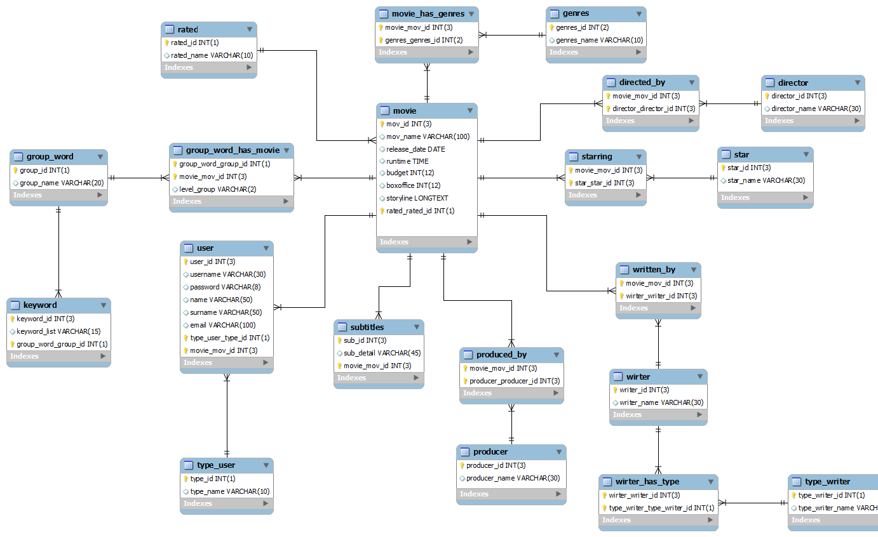
7.DATABASE CONTEXTS

Slide 16
8.WORK DONE BEFORE MID-SEMESTER
MONTH | SUMMARY
JULY | Study on various recommendation system available .
AUGUST | Analyse different recommendation algorithm ,learnt Scrappy tools to extract data.

Slide 17
9.AFTER MID-SEM
Movie names
Scrape data from wikipedia.
Raw data having Movie names, Year, Genre, Director, etc.
Get link of particular movie from movie databases site (say imdb)
Convert movie name from raw data into search link.
Sholay|1975 becomes "http://www.imdb.com/search?Sholay+1975+
With the help of above links and searching algorithm of sites we scrape the actual link.
http://www.imdb.com/title/tt0073707/
Get actual link
Scrape required rating, images link, etc.
For each actual link rating, image link is scraped
"//*[@id="ratingWidget"]/span/span/text()"
Store data into own database
Data from different sources need to be clubbed into one database based on the primary keys from different tables.

Slide 18
movie_id | movie_name | movie_director | Movie_genre | Movie_imdb_rawlink
Movie_imdb_rawlink | Movie_imdb_actuallink
Movie_imdb_actuallink | Movie_rating | Movie_image_link
Different databases are joined using MySQL queries:
SELECT list.*, imdbrating.*, rotten.rottenlink FROM imdbrating, list, imdb, rotten WHERE LTRIM(RTRIM(list. Movie_imdb_rawlink))=LTRIM(RTRIM(imdb. Movie_imdb_rawlink)) && LTRIM(RTRIM(imdb.Movie_imdb_actuallink))=LTRIM(RTRIM(imdbrating. Movie_imdb_actuallink)) && LTRIM(RTRIM(list.id))=LTRIM(RTRIM(rotten.id));

Slide 19
Register
User register into system and unique login_id is assigned.
Login
User login into system.
Suggestions
Top 20 movies have been suggested on the basis of your rating and heuristic algorithms.
New user have to rate atleast 20 movies to get suggestion.
Watched movies
Includes movies you have rated.
Movies
Includes every movie data available in our database.
On the backend, it compiles our logic code every time, you click on the Suggestions.
User database
User data/ feedback validation is stored for further improvements into the suggestion.

Slide 20
10. References
[1] (http://en.wikipedia.org/wiki/Levenshtein_distance)
[2] Anna Huang (2008) ,"Similarity Measures for Text Document Clustering" , Department of Computer Science The University of Waikato, Hamilton, New Zealand.
[3] Tianqui Chen. “ SVDFeature : A Toolkit for Feature-based Collaborative Filtering,” Shanghai Jiao Tong University.
[4] http://www.cnet.com/news/top-10-movie-recommendation-engines/
[5] http://maheshakya.github.io/gsoc/2014/05/18/preparing-a-bench-marking-data-set-using-singula-value-decomposition-on-movielens-data.html

